Slide 1
Origin of Lifetime Enhancement in Mixed Emissive Layer Organic Light-Emitting Devices
John Bangsund

Slide 2
Paper figure outline
Device architecture, EQE
RZ measurement
EL, PL, and gamma vs t for fixed luminance and scaled luminance
t85 PL and gamma vs L0 and 1/dEML (add third subfigure with gamma t85, t75, t60 vs 1/dEML to show change in slope?)
The maximum published width for a one-column figure is 3.37 inches (8.5 cm). The maximum width for a two-column figure is 6.69 inches (17 cm).

Slide 3
1. Device Architecture, EQE and Lifetime
Figure 1 - Suddard-Bangsund et al.
Notes:
Figure 1. a) Device architecture schematic for M-EML devices employed in this work. The HTL/M-EML/ETL thickness is kept constant at 100 nm by varying the transport layer thicknesses equally, and the M-EML width (d_{EML}) is varied from 10 to 60 nm. b) EQE characteristics as a function of EML thickness. Peak EQE increases slightly at higher EML thickness, and the onset of roll-off is also delayed to higher current densities.
All data from 2-16-17

Slide 4
3. EL-PL thickness dependence
Figure 3 - Suddard-Bangsund et al.

Slide 5
4. EL+PL: Exciton Density Scaling
Figure 4 - Suddard-Bangsund et al.
Notes:
Figure 3. (a) Normalized electroluminescence (EL) intensity for 10, 30, and 60 nm M-EML devices operated at an initial luminance of 3 kcd/m². The current densities for these tests were 7.2, 6.4, and 6.0 mA/cm², respectively. (b) The decoupled photoluminescence (PL, symbols) and exciton formation efficiency losses ($γ$, solid lines) corresponding to the curves in (a). (c) Decoupled PL and $γ$ losses for 10, 30, and 60 nm M-EML devices operated at 1, 3, and 6 kcd/m², respectively. The current densities for these tests were 2.0, 6.0, and 12.0 mA/cm², respectively.

Slide 6
5. t₅₀ vs. L₀ and 1/d_{EML}
alternative:
Figure 5 - Suddard-Bangsund et al.
Notes:
Figure 4.

Slide 7
2. Recombination Zone Measurement
Figure 2 - Suddard-Bangsund et al.
Notes:
Figure 2. a) Counts-normalized electroluminescence spectra for sensitized 60 nm M-EML devices at J = 1 mA/cm² with sensitizer doped strips centered at 5, 15, 30, 45, and 55 nm from the HTL. b) Normalized exciton density profiles for 0.1, 1, and 10 mA/cm². Solid lines are guides to the eye. Error bars in position represent the width of the dopant strips and the Förster radius between Ir(ppy)₃ and PtTPBP (3.7 nm). Error bars in relative exciton density represent standard deviations taken from a minimum of four samples. c) Electric field profile of the PL pump (λ = 405 nm) and the spectrally-weighted outcoupling efficiency for Ir(ppy)₃ emission.

Slide 8
SI Figures

Slide 9
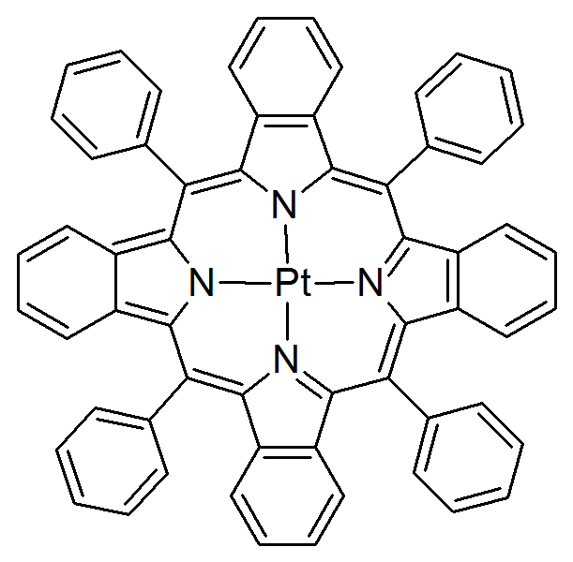
2.4
2.6
TCTA
2.9
2.8
TPBi
Energy
PtTPBP
PtTPBP
T₁ = 1.6 eV
R₀=3.7 nm
Ir(ppy)₃
4.8
5.1
5.7
6.1
(a)
(b)

Slide 11
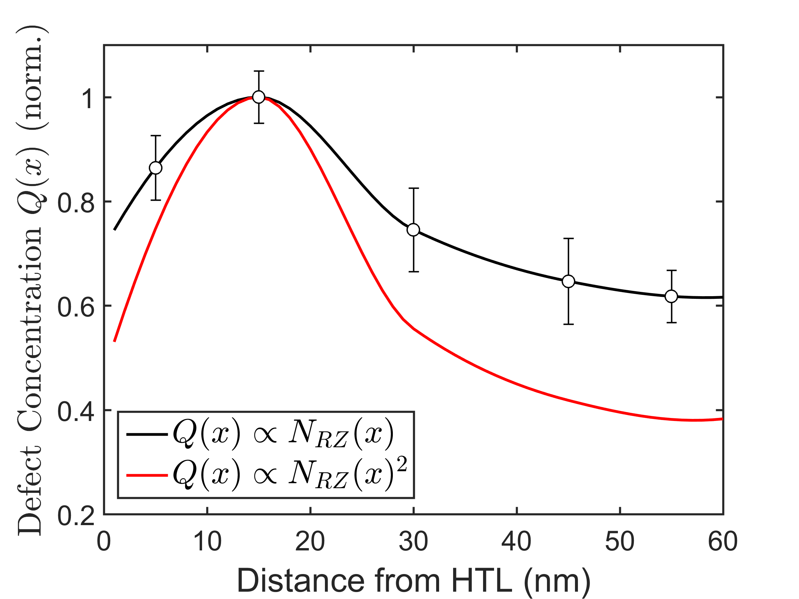
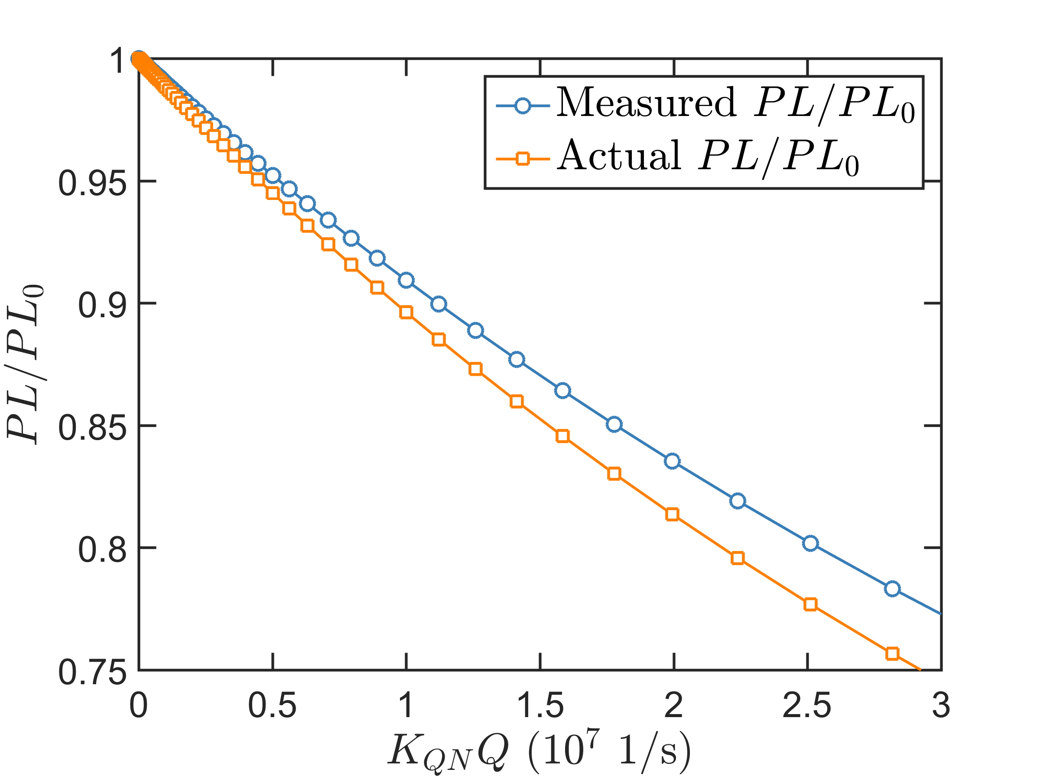
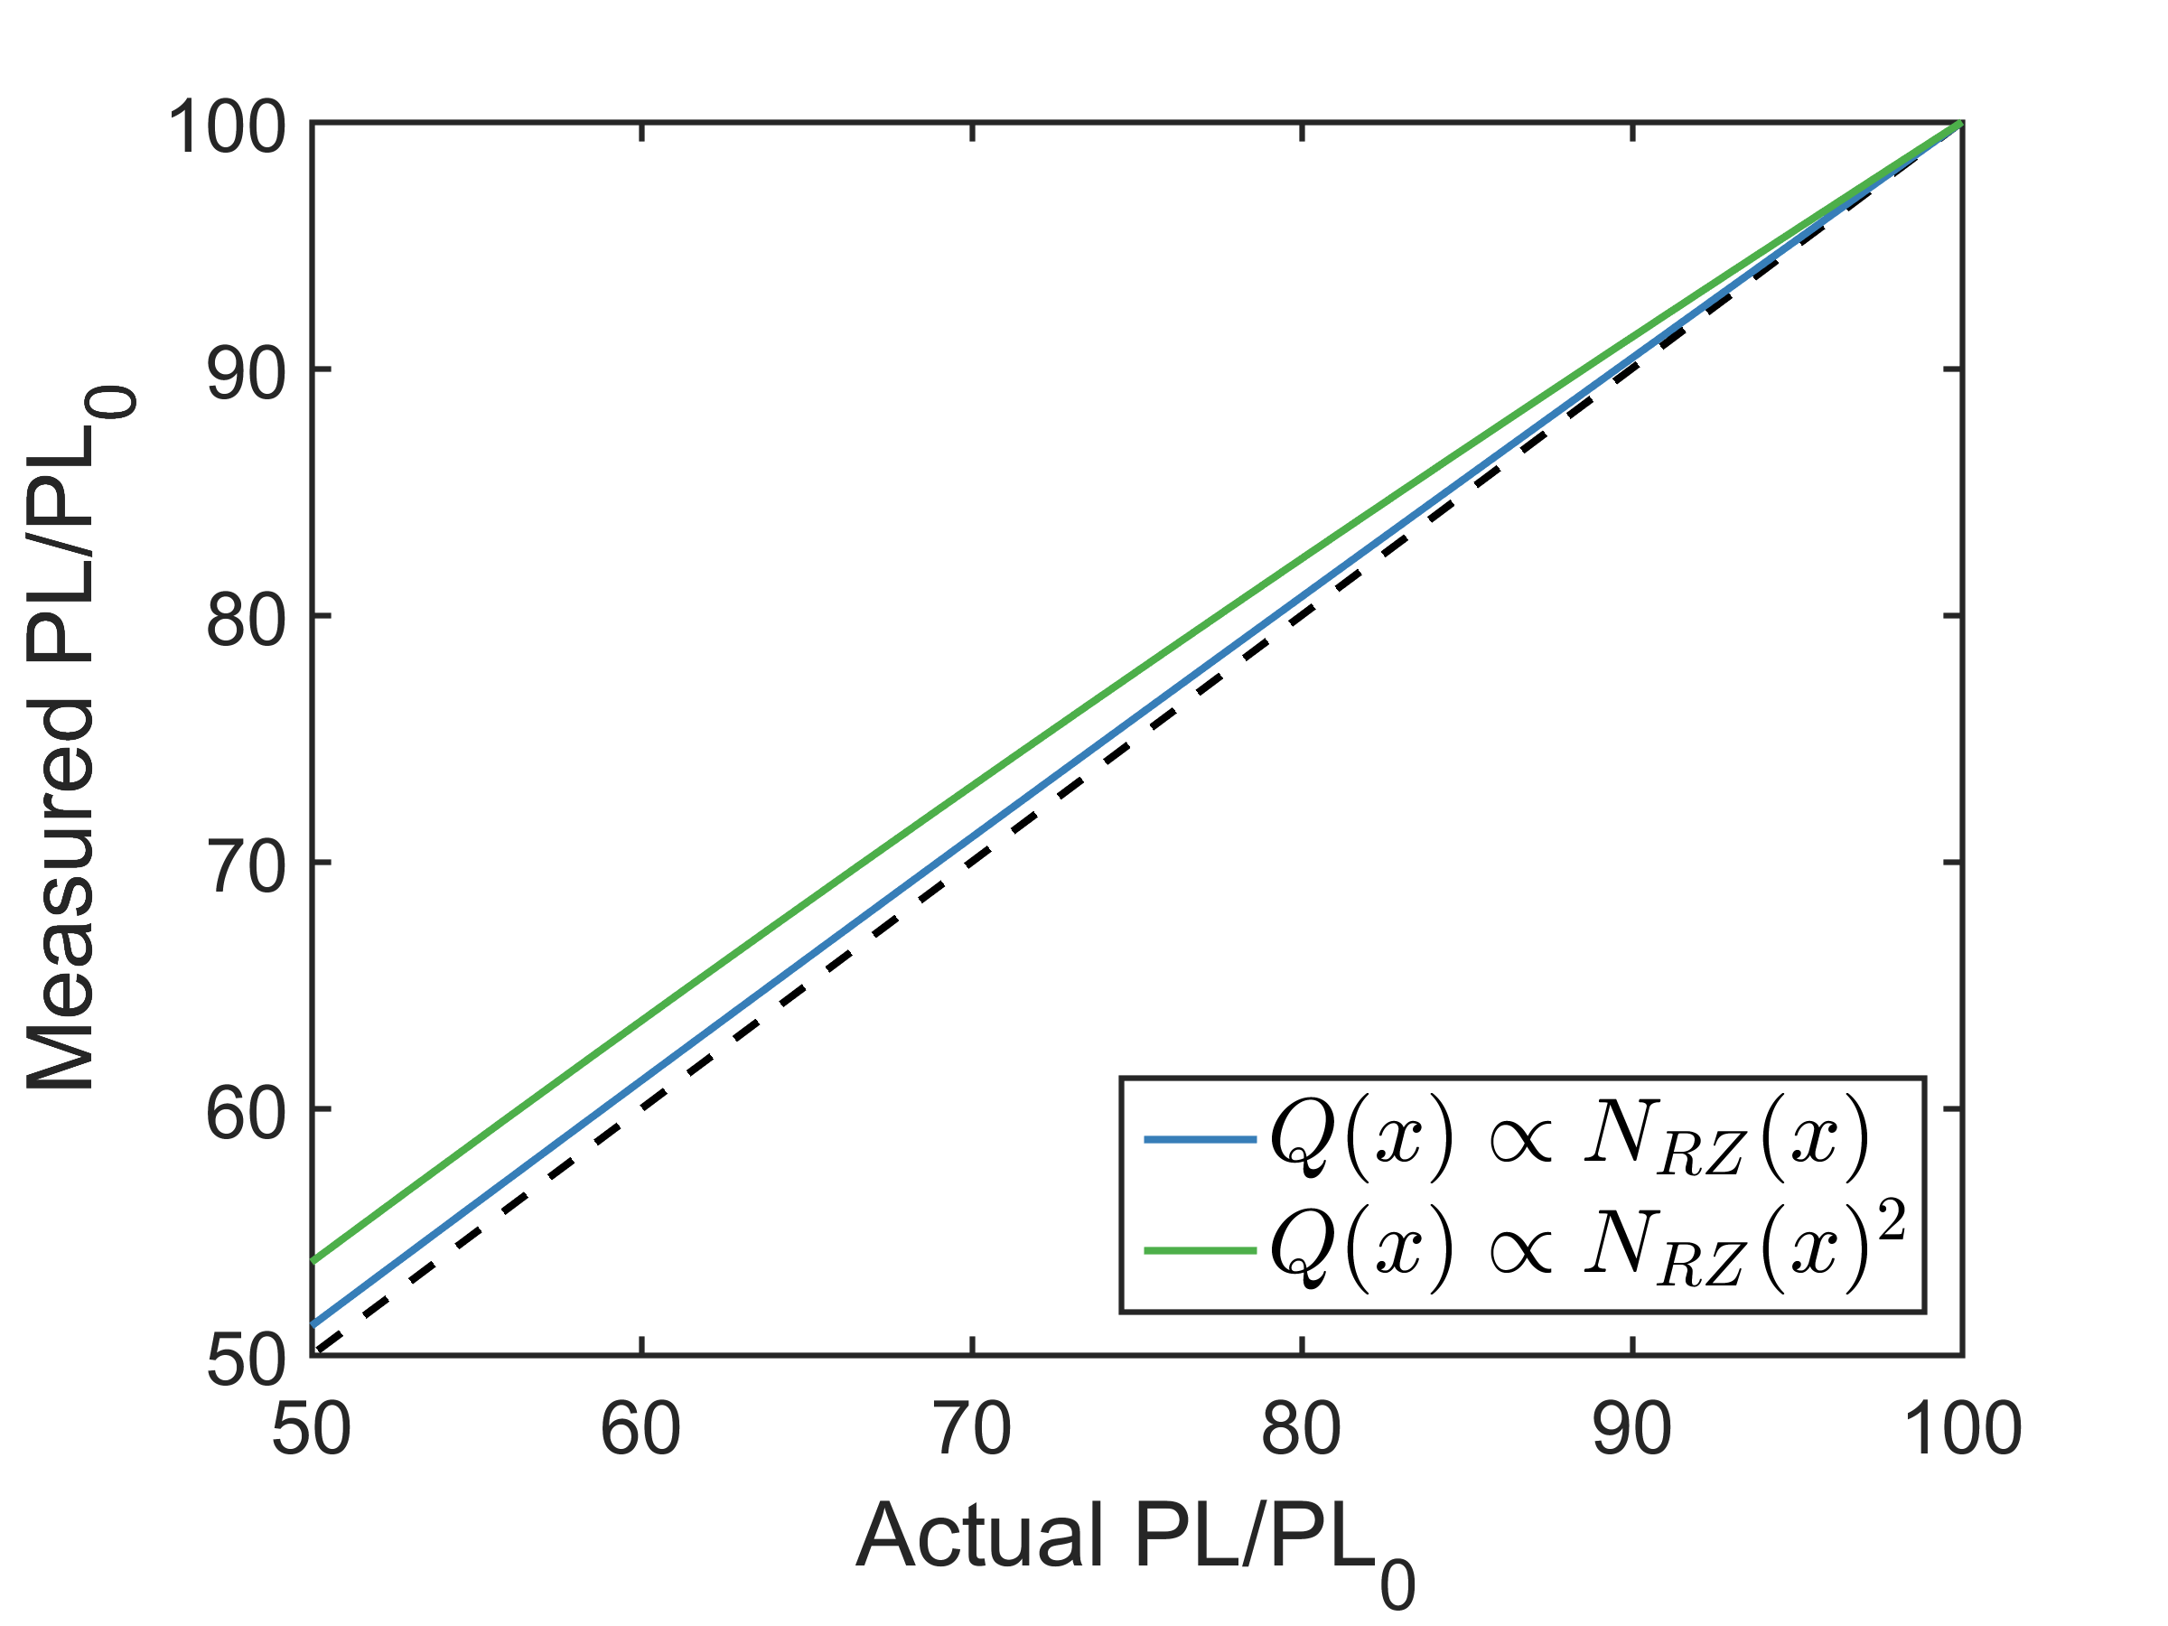
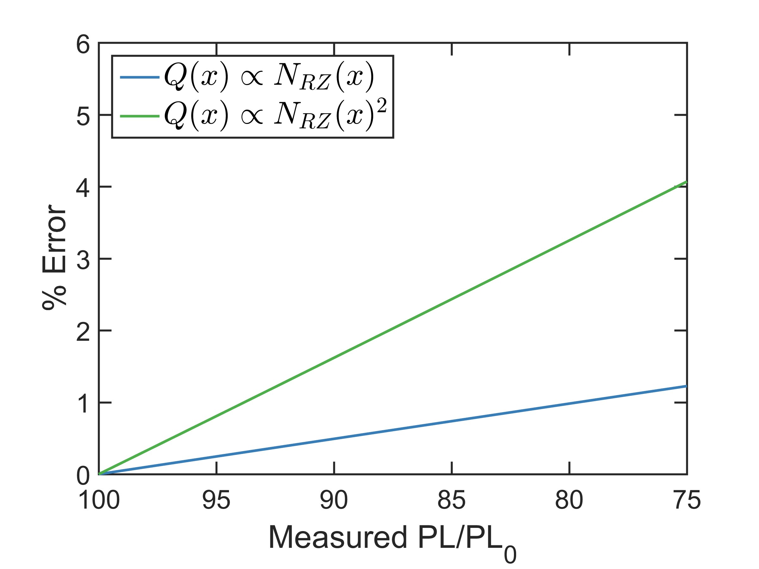
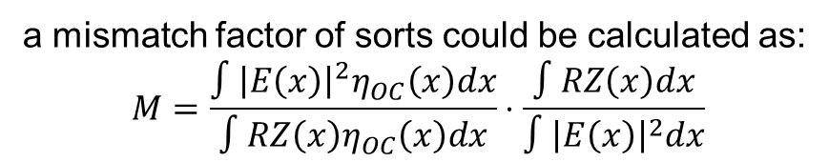
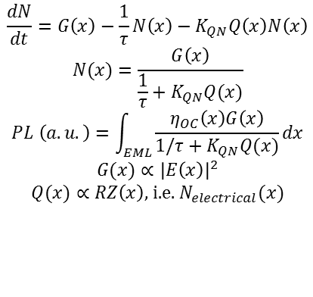
(a)
(b)
(c)
(d)
$$\frac{dN}{dt}=G\left(x\right)−\frac{1}{τ}N\left(x\right)−K_{QN}Q\left(x\right)N\left(x\right)$$
$$N(x)=\frac{G\left(x\right)}{\frac{1}{τ}+K_{QN}Q(x)}$$
$$PL \left(a.u.\right)=\int_{EML}{\frac{η_{OC}\left(x\right)G\left(x\right)}{1/τ+K_{QN}Q(x)}dx}$$
$$G(x)∝{\left|E\left(x\right)\right|}^{2}$$
$$Q(x)∝RZ\left(x\right)\text{, }\text{i}\text{.}\text{e}\text{. }N_{electrical}(x)$$
a mismatch factor of sorts could be calculated as:
$$M=\frac{∫{\left|E\left(x\right)\right|}^{2}η_{OC}\left(x\right)dx}{∫RZ\left(x\right)η_{OC}\left(x\right)dx}⋅\frac{∫RZ\left(x\right)dx}{∫{\left|E\left(x\right)\right|}^{2}dx}$$

Slide 12
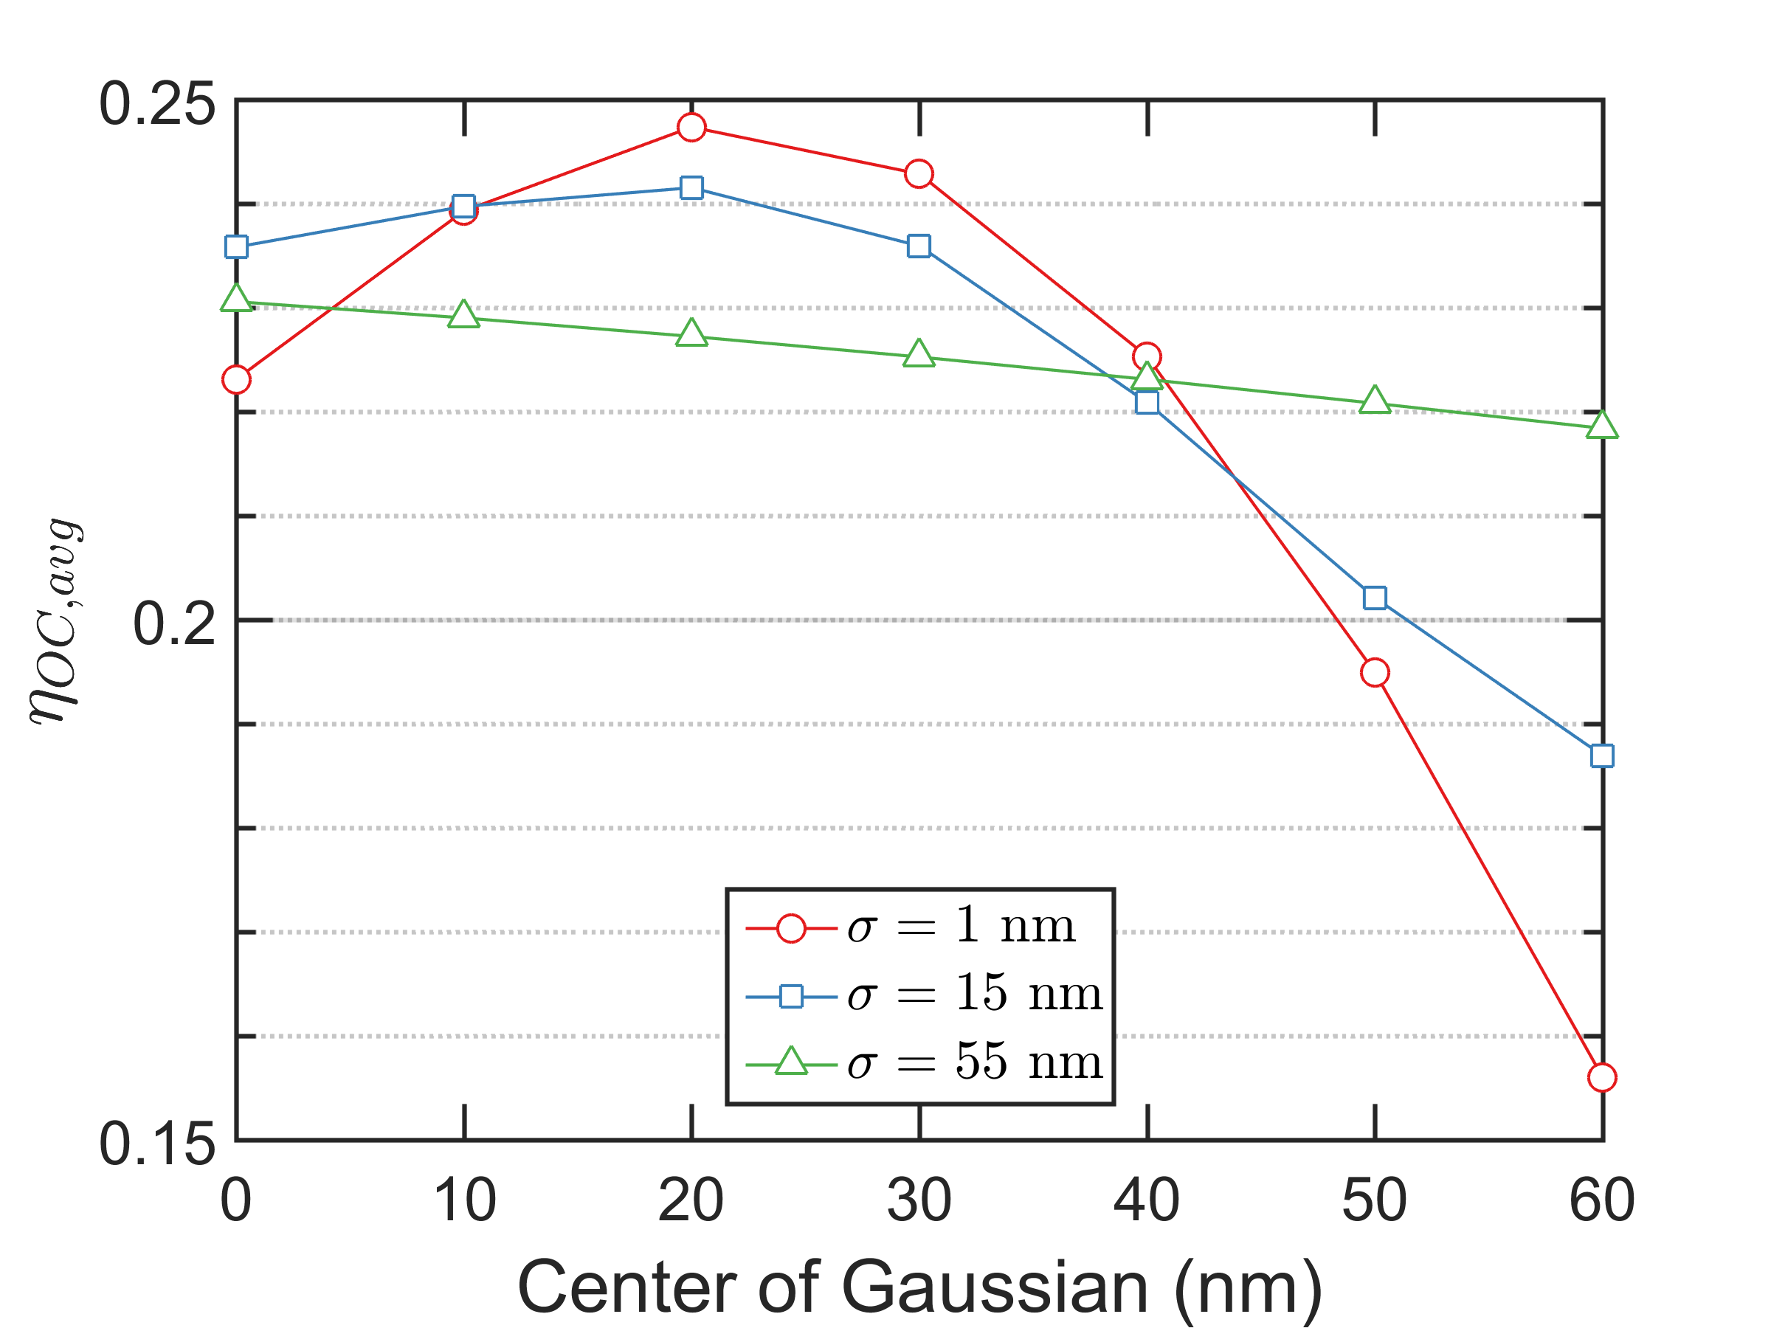
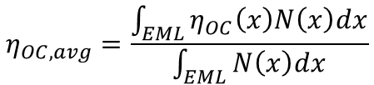
$$η_{OC,avg}=\frac{\int_{EML}{η_{OC}\left(x\right)N\left(x\right)dx}}{\int_{EML}{N\left(x\right)dx}}$$
(a)
(b)

Slide 13
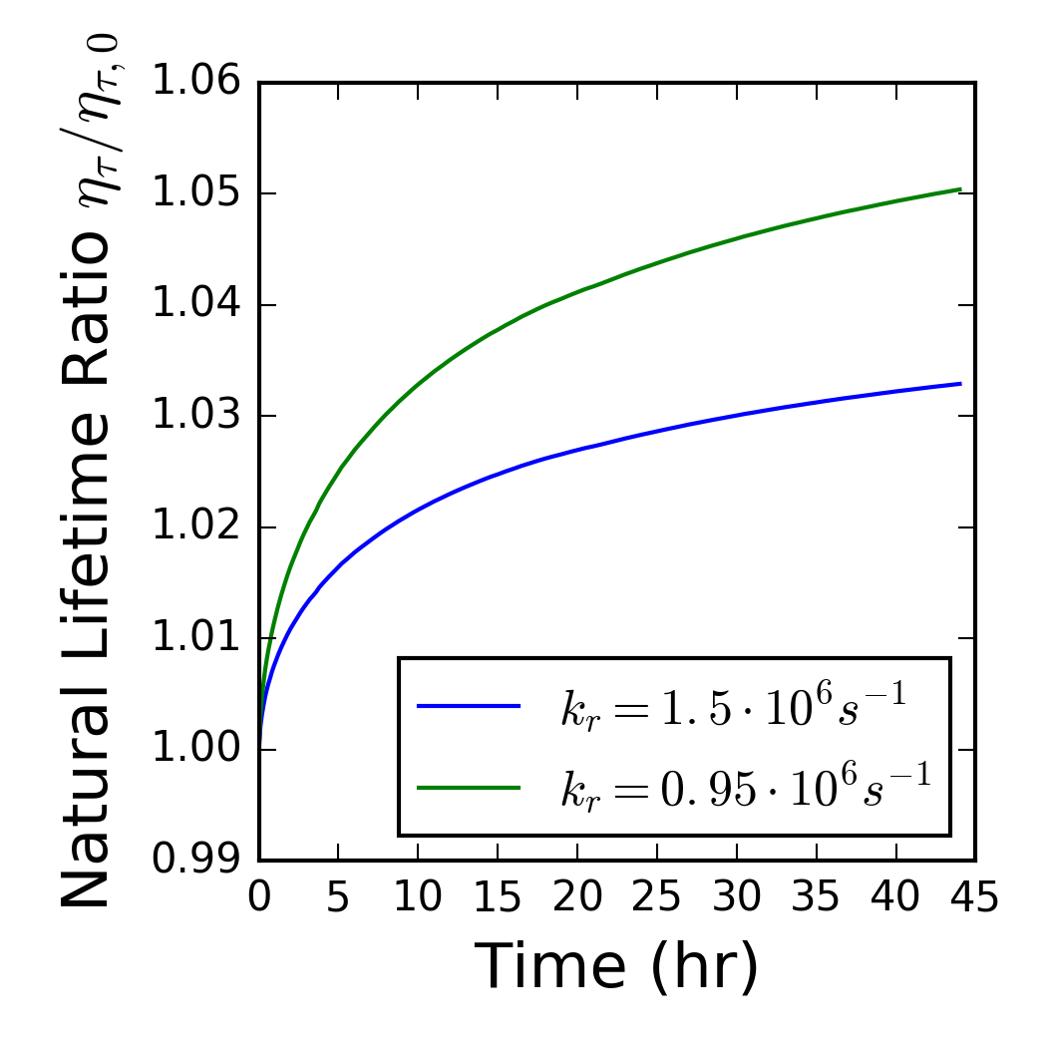
Choice of $k_{r}$ / $τ$ influences estimates of $\frac{η_{τ}}{η_{τ,0}}$

